Slide 1
Complete Formations
Same Day Company Incorporation Services
Form your company in Minutes at
www.completeformations.co.uk
Third Floor 207 Regent Street London W1B 3HH
© All Rights Reserved

Slide 2
How to Form a Company
Complete Formations
Same Day Company Incorporation Services
Companies Limited by Shares
Form your company in Minutes at
www.completeformations.co.uk
Third Floor 207 Regent Street London W1B 3HH
© All Rights Reserved

Slide 3
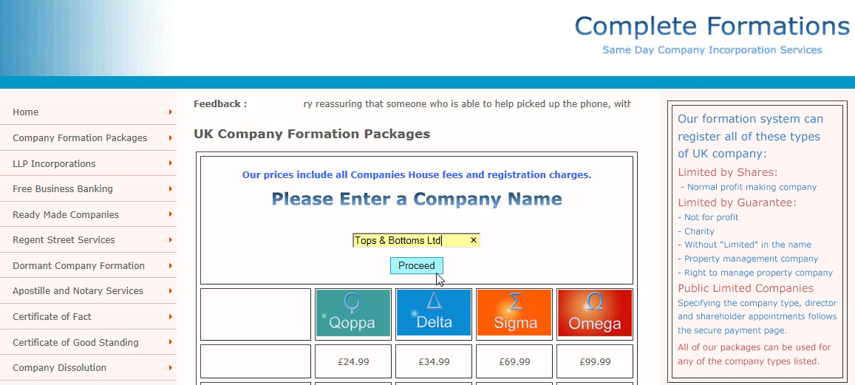
Complete Formations
Same Day Company Incorporation Services
Enter your chosen company name
Click on “Proceed”
Form your company in Minutes at
www.completeformations.co.uk
Third Floor 207 Regent Street London W1B 3HH
© All Rights Reserved

Slide 4
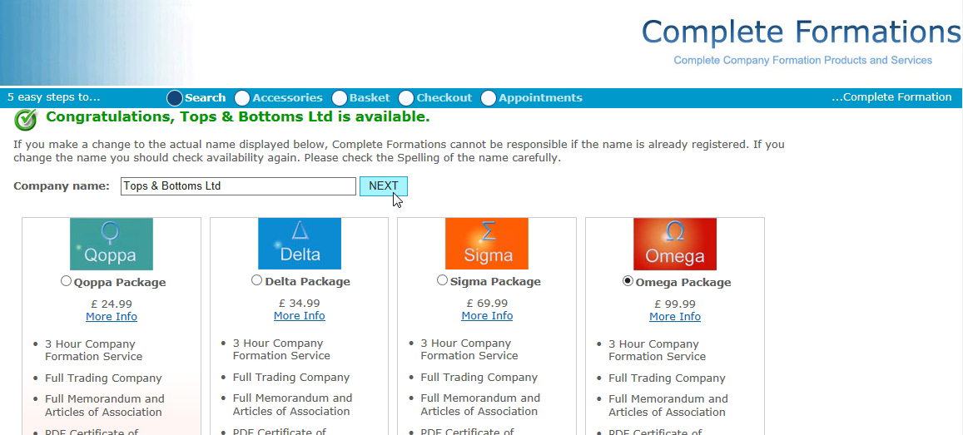
Complete Formations
Same Day Company Incorporation Services
Select your package
Click on “Next”
Form your company in Minutes at
www.completeformations.co.uk
Third Floor 207 Regent Street London W1B 3HH
© All Rights Reserved

Slide 5
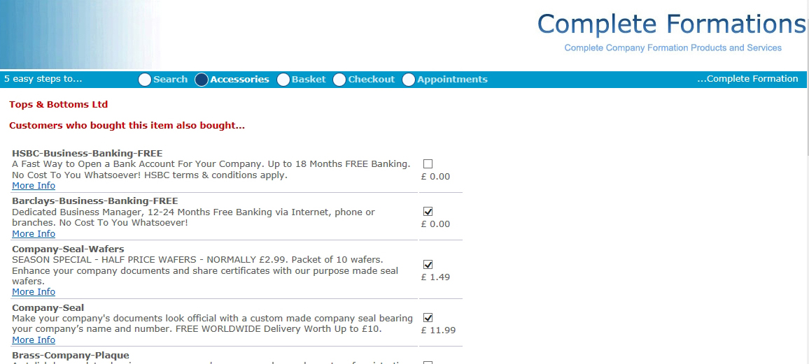
Complete Formations
Same Day Company Incorporation Services
Select your Accessories
Scroll to the bottom of the page
Form your company in Minutes at
www.completeformations.co.uk
Third Floor 207 Regent Street London W1B 3HH
© All Rights Reserved

Slide 6
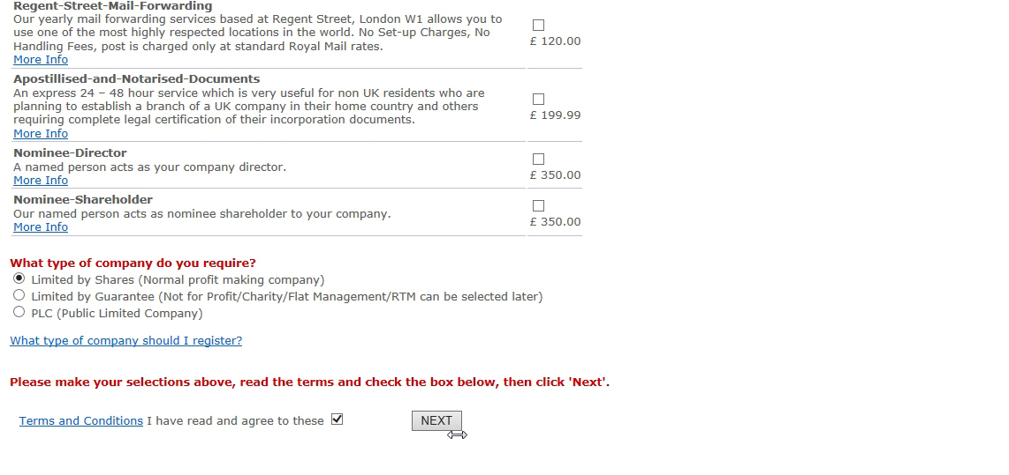
Complete Formations
Same Day Company Incorporation Services
Agree to the terms and conditions
Click on “Next”
Form your company in Minutes at
www.completeformations.co.uk
Third Floor 207 Regent Street London W1B 3HH
© All Rights Reserved

Slide 7
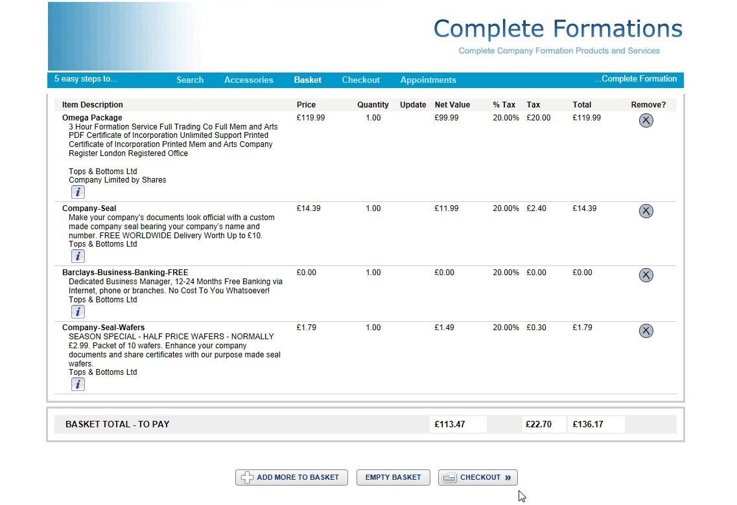
Complete Formations
Same Day Company Incorporation Services
Click on Checkout”
Form your company in Minutes at
www.completeformations.co.uk
Third Floor 207 Regent Street London W1B 3HH
© All Rights Reserved

Slide 8
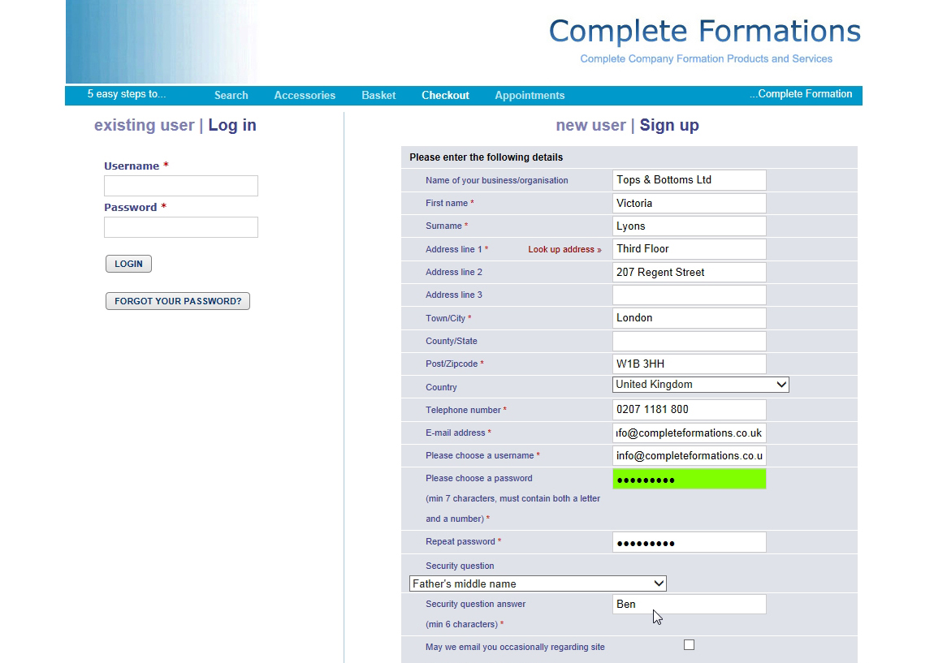
Complete Formations
Same Day Company Incorporation Services
Enter the purchaser’s details
Note: This is not necessarily the director or shareholder details. That comes later.
Form your company in Minutes at
www.completeformations.co.uk
Third Floor 207 Regent Street London W1B 3HH
© All Rights Reserved

Slide 9
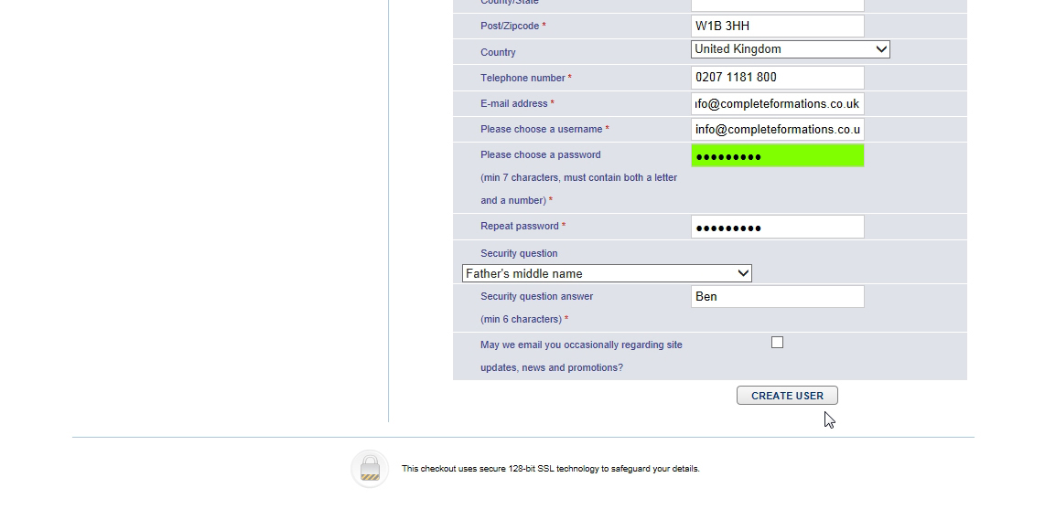
Complete Formations
Same Day Company Incorporation Services
Click on “Create User”
Form your company in Minutes at
www.completeformations.co.uk
Third Floor 207 Regent Street London W1B 3HH
© All Rights Reserved

Slide 10
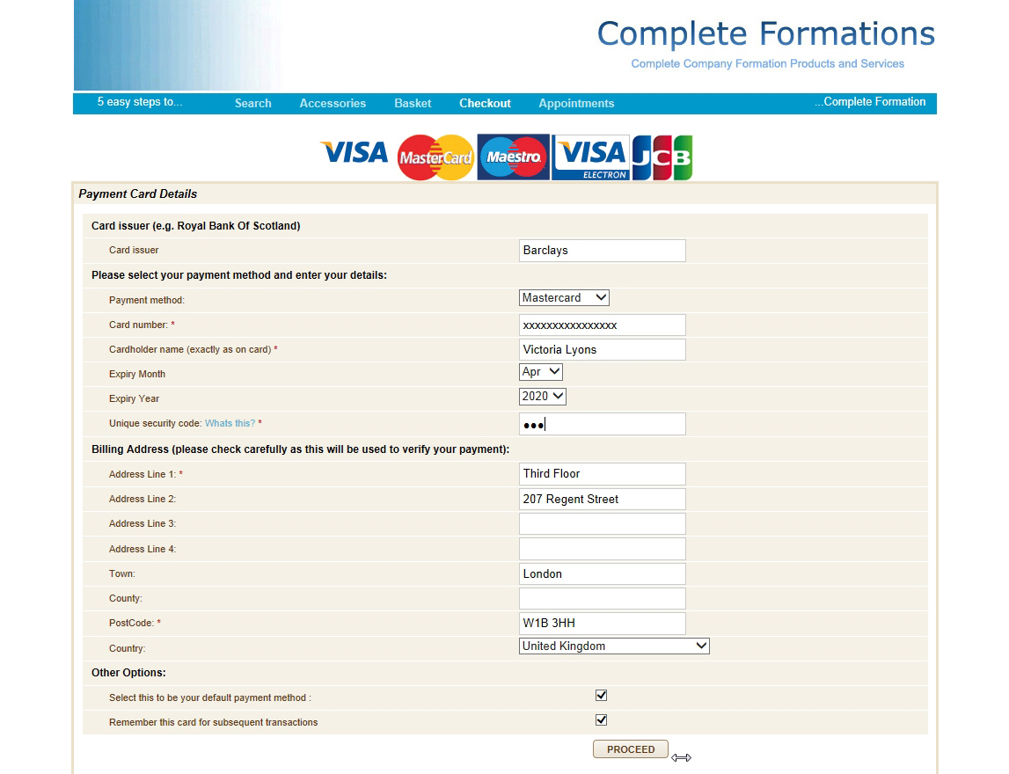
Complete Formations
Same Day Company Incorporation Services
Enter payment details
Click on “Proceed”
Form your company in Minutes at
www.completeformations.co.uk
Third Floor 207 Regent Street London W1B 3HH
© All Rights Reserved

Slide 11
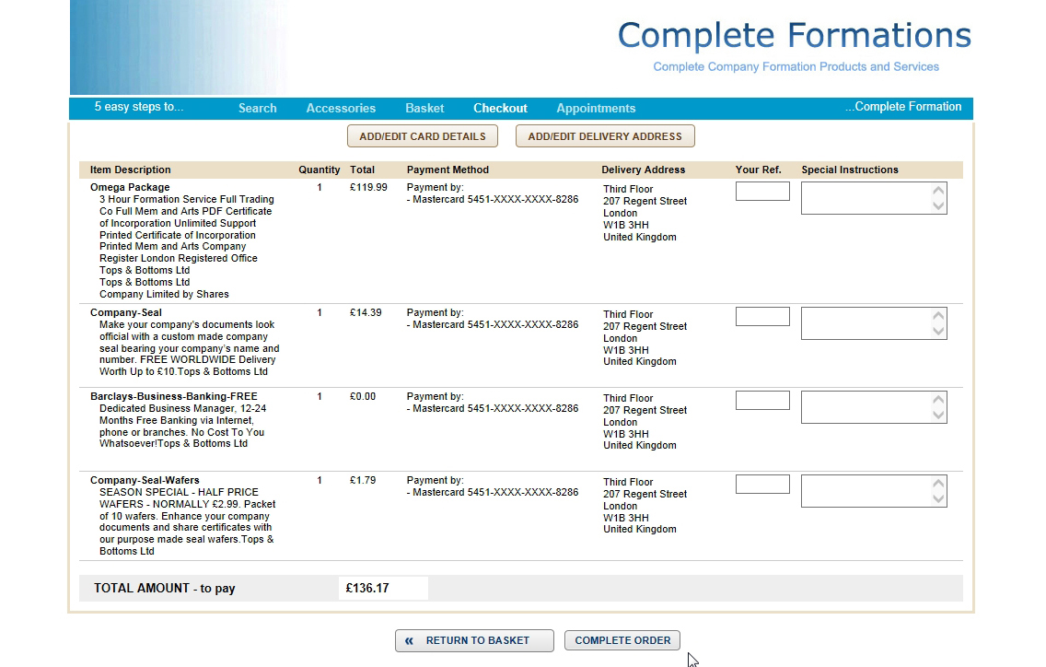
Complete Formations
Same Day Company Incorporation Services
Click on “Complete Order”
Form your company in Minutes at
www.completeformations.co.uk
Third Floor 207 Regent Street London W1B 3HH
© All Rights Reserved

Slide 12
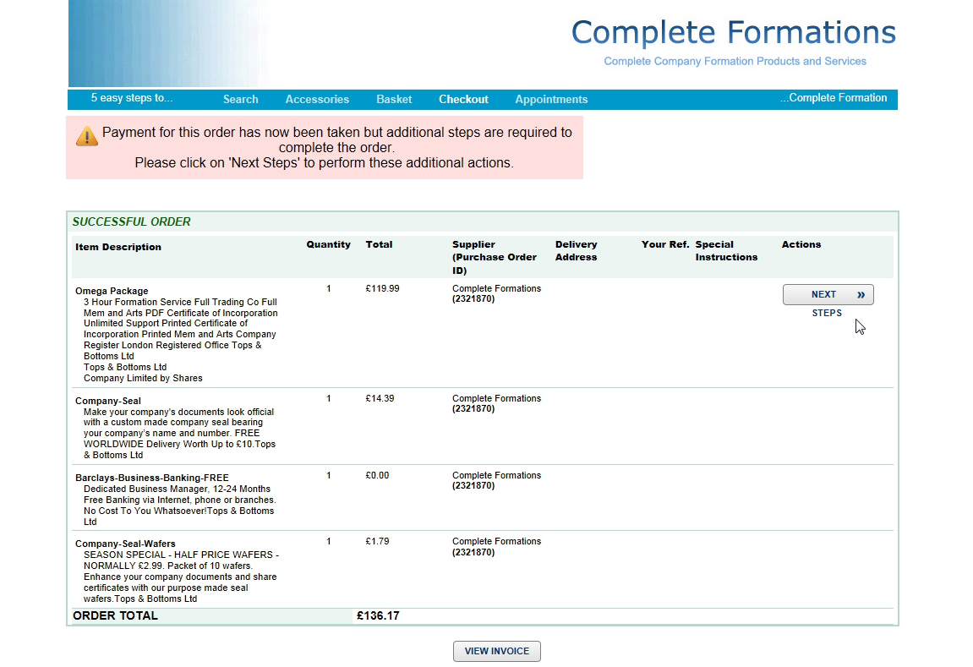
Complete Formations
Same Day Company Incorporation Services
Click on “Next Steps”
Form your company in Minutes at
www.completeformations.co.uk
Third Floor 207 Regent Street London W1B 3HH
© All Rights Reserved

Slide 13
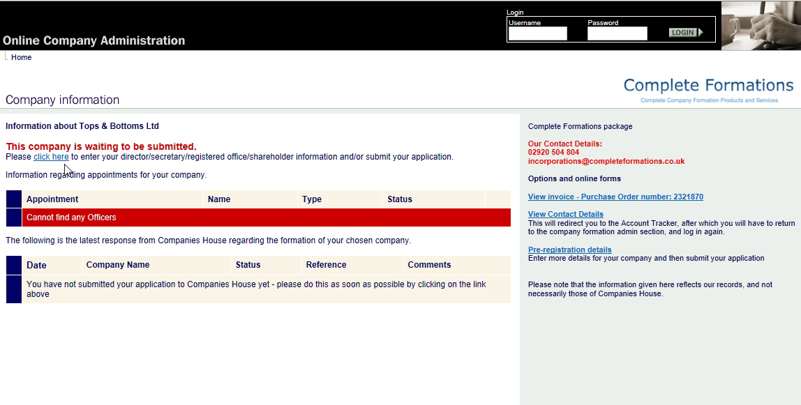
Complete Formations
Same Day Company Incorporation Services
Click on “Click Here”
Form your company in Minutes at
www.completeformations.co.uk
Third Floor 207 Regent Street London W1B 3HH
© All Rights Reserved

Slide 14
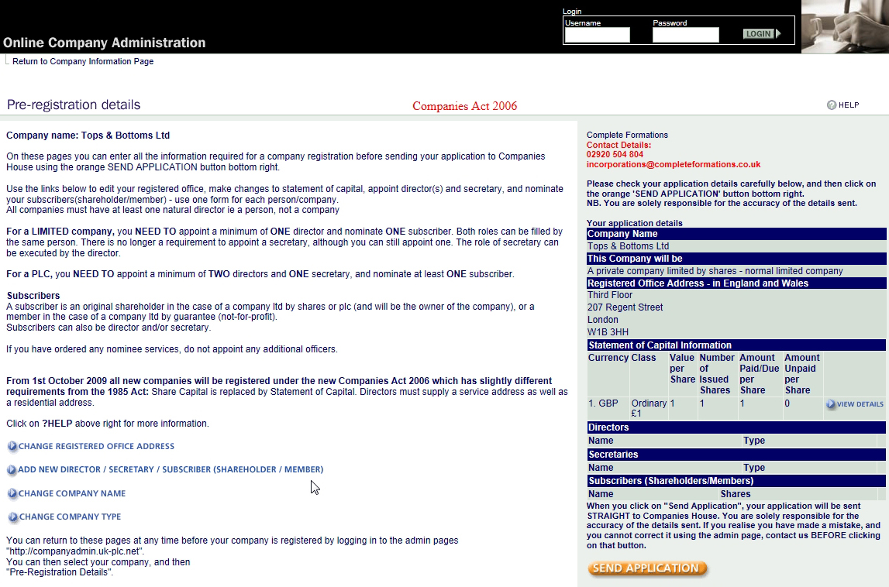
Complete Formations
Same Day Company Incorporation Services
Click on “Add New Director/ Secretary/ Subscriber (Shareholder/ Member)”
Form your company in Minutes at
www.completeformations.co.uk
Third Floor 207 Regent Street London W1B 3HH
© All Rights Reserved

Slide 15
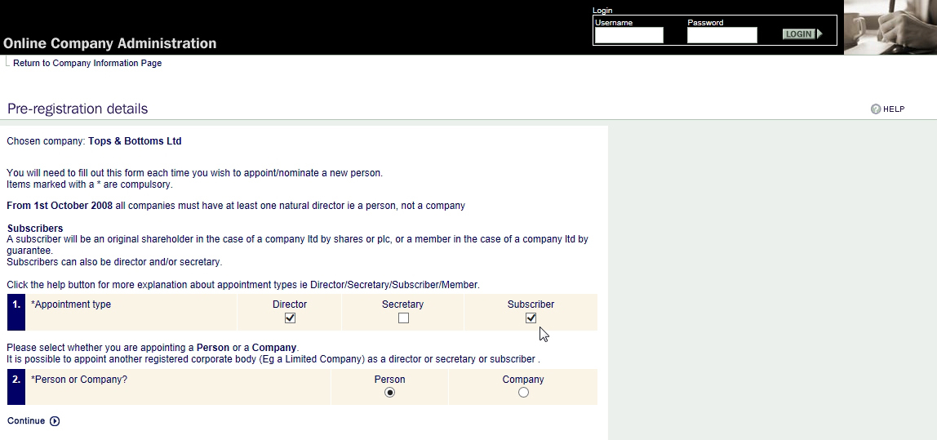
Complete Formations
Same Day Company Incorporation Services
Appoint a person as a Director & Subscriber (shareholder)
Form your company in Minutes at
www.completeformations.co.uk
Third Floor 207 Regent Street London W1B 3HH
© All Rights Reserved

Slide 16
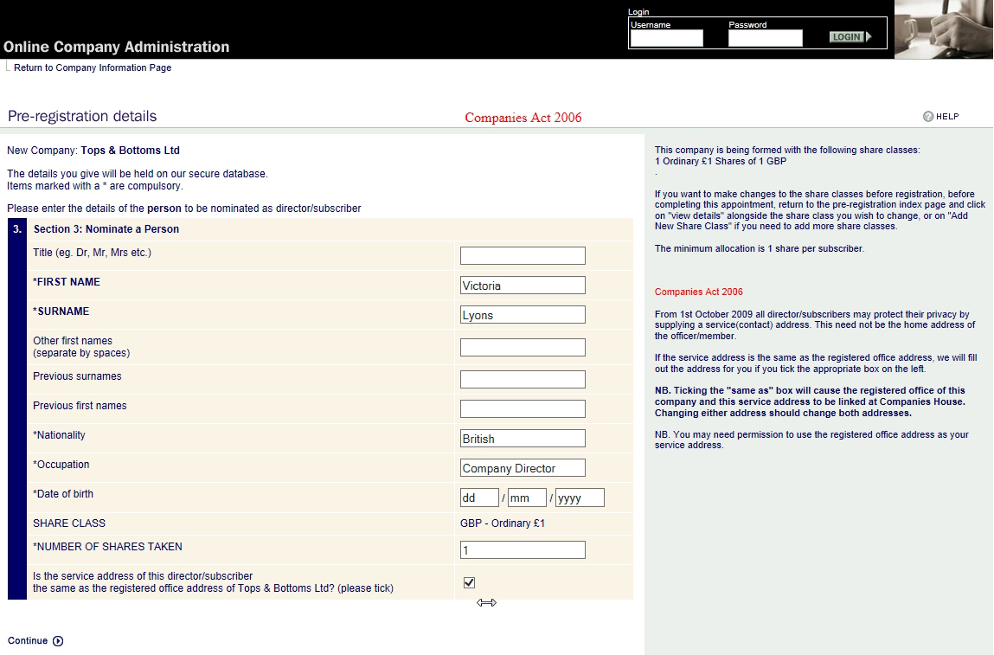
Complete Formations
Same Day Company Incorporation Services
Complete the Director’s & Shareholder’s details
Note: The service address is the one shown on the public records.
Form your company in Minutes at
www.completeformations.co.uk
Third Floor 207 Regent Street London W1B 3HH
© All Rights Reserved

Slide 17
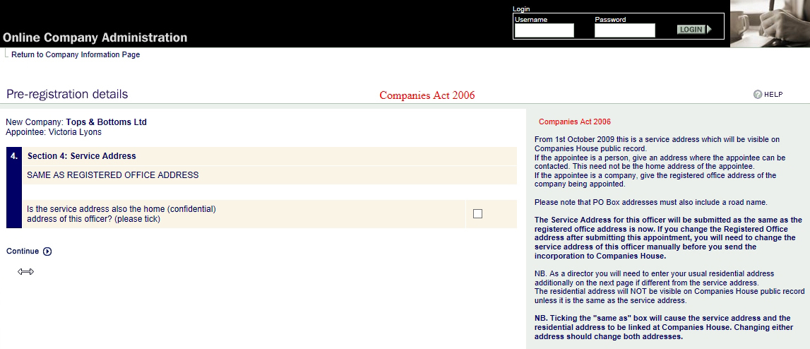
Complete Formations
Same Day Company Incorporation Services
If the registered office address is also the residential address, tick the box
Click on “Continue”
Form your company in Minutes at
www.completeformations.co.uk
Third Floor 207 Regent Street London W1B 3HH
© All Rights Reserved

Slide 18
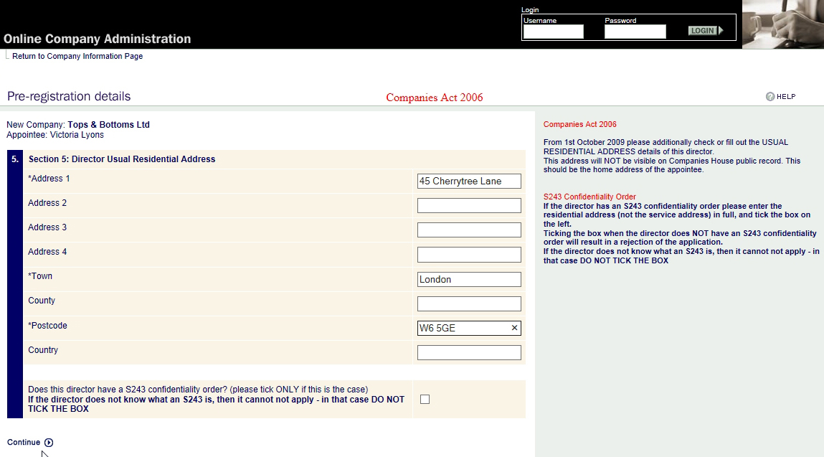
Complete Formations
Same Day Company Incorporation Services
Enter the residential address
Click on “Continue”
Form your company in Minutes at
www.completeformations.co.uk
Third Floor 207 Regent Street London W1B 3HH
© All Rights Reserved

Slide 19
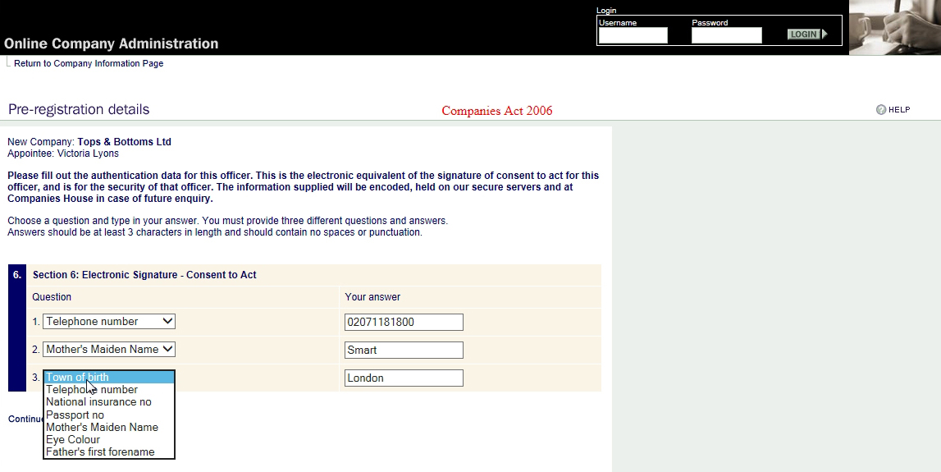
Complete Formations
Same Day Company Incorporation Services
Complete any 3 from the 7 security questions
Note: There must be no spaces in your answers
Form your company in Minutes at
www.completeformations.co.uk
Third Floor 207 Regent Street London W1B 3HH
© All Rights Reserved

Slide 20
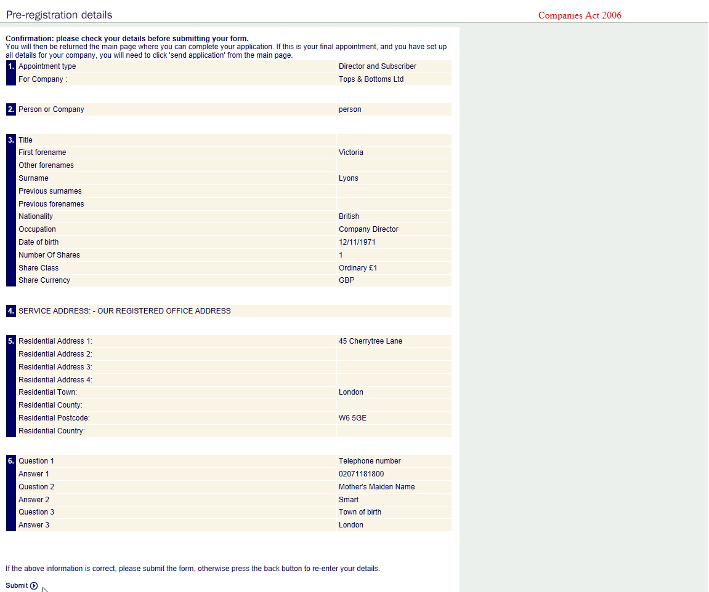
Complete Formations
Same Day Company Incorporation Services
Final Check
Click on “Submit”
Form your company in Minutes at
www.completeformations.co.uk
Third Floor 207 Regent Street London W1B 3HH
© All Rights Reserved

Slide 21
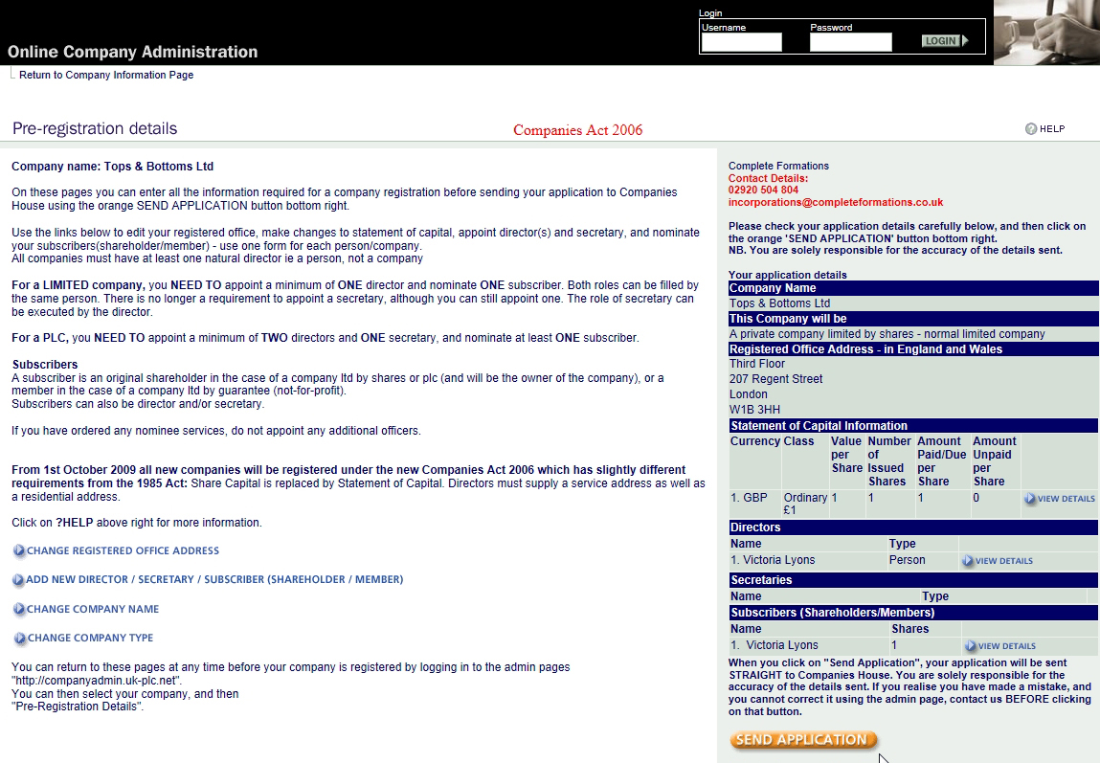
Complete Formations
Same Day Company Incorporation Services
Submitted details appear on the right
You can add more directors & shareholders if you wish
Click on “Send Application”
Form your company in Minutes at
www.completeformations.co.uk
Third Floor 207 Regent Street London W1B 3HH
© All Rights Reserved

Slide 22
Complete Formations
Same Day Company Incorporation Services
Confirmation screen
Form your company in Minutes at
www.completeformations.co.uk
Third Floor 207 Regent Street London W1B 3HH
© All Rights Reserved

Slide 23
You will receive your Memorandum and Articles of Association in a few minutes and your PDF Certificate of Incorporation in approximately 1-3 hours
Complete Formations
Same Day Company Incorporation Services
Thank You for watching
Form your company in Minutes at
www.completeformations.co.uk
Third Floor 207 Regent Street London W1B 3HH
© All Rights Reserved

